Slide 1

PCWG-Share-02 Provisional Results
PCWG Meeting Copenhagen
Peter Stuart (RES) & Jason Fields (NREL)

Slide 2
WARNING: RESULTS ARE PROVISIONAL
The PCWG-Share-X platform continues to be refined and extended. Whilst much progress has been made, the PCWG-Share-2 results should still be considered provisional.
The results contained in this presentation should therefore be considered informative rather than definitive.

Slide 3
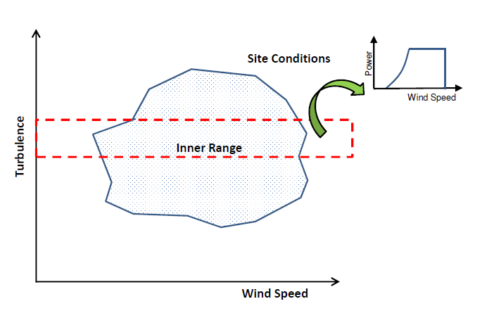
PCWG-Share-X: Neutralising Commercial Sensitivities
Inner Range Power Curves Extracted from the Dataset Itself: the data analysis process has been designed such that the warranted power curve is never considered. Instead a power curve is extracted from a subset of the data (Inner-Range) which is then used to model the power output in the outer-range.
Intelligence Sharing, not Data Sharing: the data analysis process has been designed such that the datasets do not need to be shared outside of the participant organisations. Instead of sharing the actual data, participants will share performance metrics which describe the accuracy of the trial methodologies.

Slide 4
PCWG-Share-X: Data Flow
Hypothesis/Trial Methodology
Analysis Definition Y
Analysis Definition Y
Analysis Definition Y
Analysis Definition Y
Proprietary Dataset A
Proprietary Dataset B
Proprietary Dataset C
Proprietary Dataset D
Organization A
Organization B
Organization C
Organization D
Hypothesis Performance Metrics
Aggregator
(NREL)
Combination Analysis
How well did the trial method perform?
Aggregated Hypothesis Performance Metrics

Slide 5
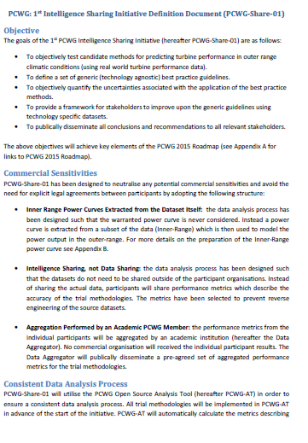
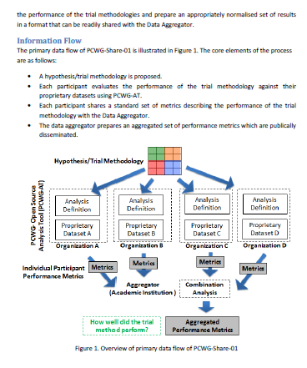
PCWG-Share-X Definition Document
Download PCWG-Share-X Definition Doc from www.pcwg.prg

Slide 6
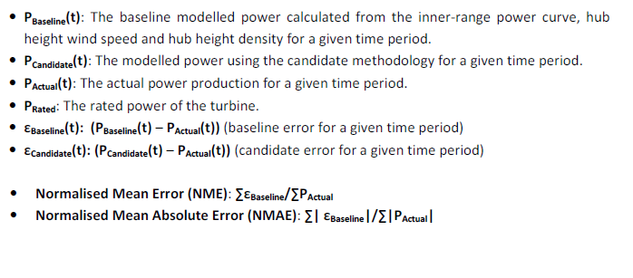
PCWG-Share-02: Error Metric Definitions
See PCWG-Share-X Definition Document for Further Details

Slide 7
PCWG-Share-02
Methods being Tested
IEC Turbulence Correction
REWS (Speed, Veer & Upflow) - REWS (S, V & U)
RAWS (Speed, Veer & Upflow) - RAWS (S, V & U)
2D Power Deviation Matrix
3D Power Deviation Matrix
Production by Height

Slide 8
PCWG-Share-02: Datasets
51 Datasets (of which 6 are Remote Sensing Datasets)
3 datasets rejected due to clearly bad data in normalised scatter plot
1 dataset reject due to abnormally high scatter (more investigation needed)
→ Final 47 Datasets (of which 6 are Remote Sensing Datasets)
Remote Sensing Datasets:
6 in total
3 with Veer
0 with Upflow – Not possible to test REWS with Upflow this time

Slide 9
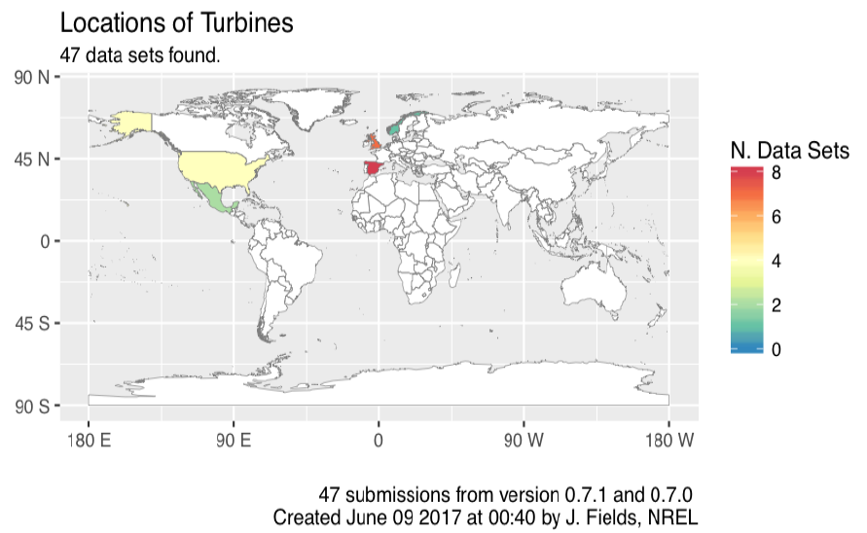
PCWG-Share-02: Submission Map

Slide 10
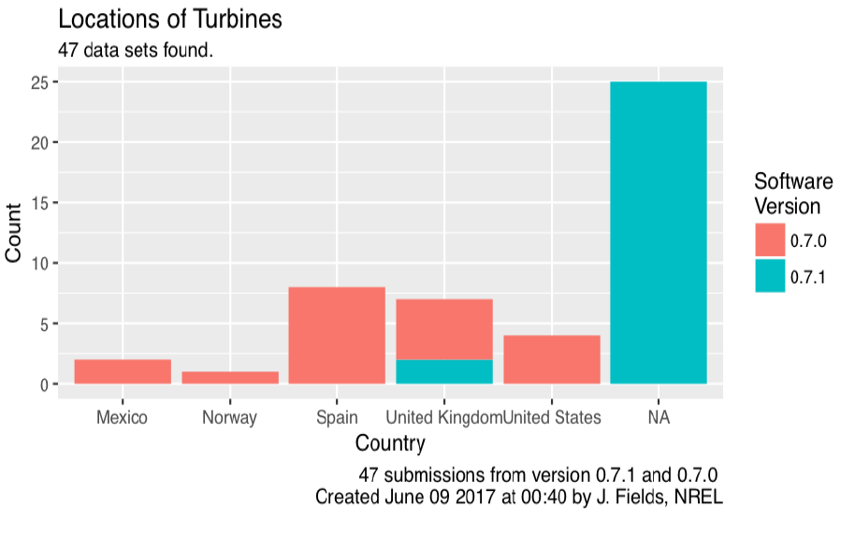
PCWG-Share-02: Submissions by Country
Meta data not specified

Slide 11
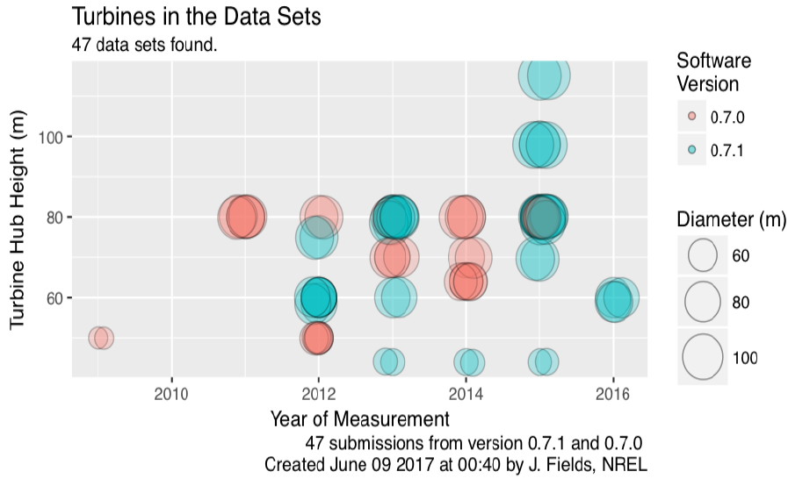
PCWG-Share-02: Turbine Size vs Measurement Year

Slide 12
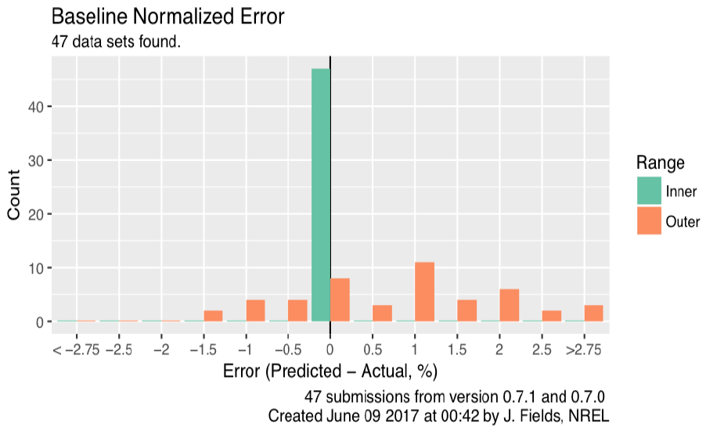
PCWG-Share-02: Baseline Error, Inner vs Outer Range
Inner Range baseline errors are all close to zero (self-consistent)
Spread of Outer Range Results representative of Outer Range Modelling Uncertainty.

Slide 13
PCWG-Share-02
Provisional RESULTS

Slide 14
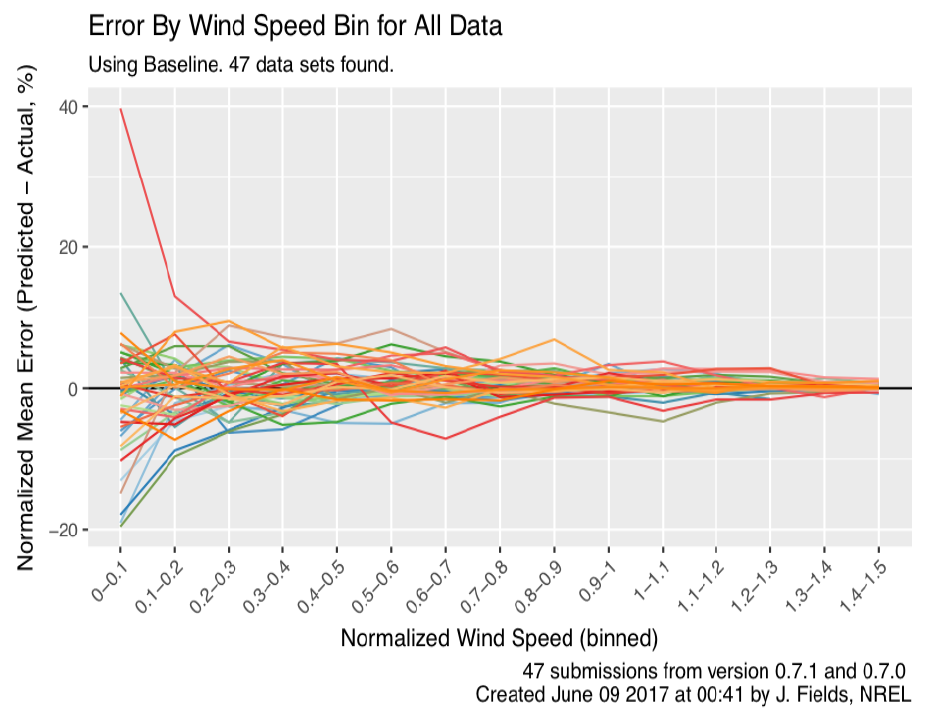
PCWG-Share-02: Baseline Errors by Wind Speed

Slide 15
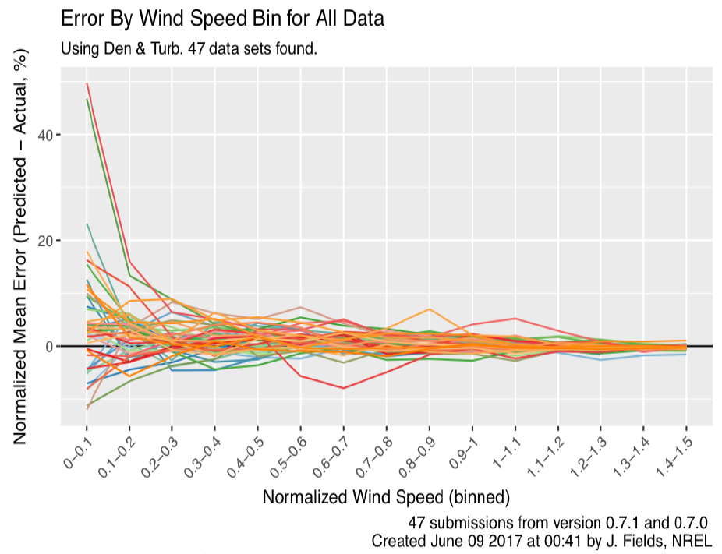
PCWG-Share-02: Turb Errors by Wind Speed

Slide 16
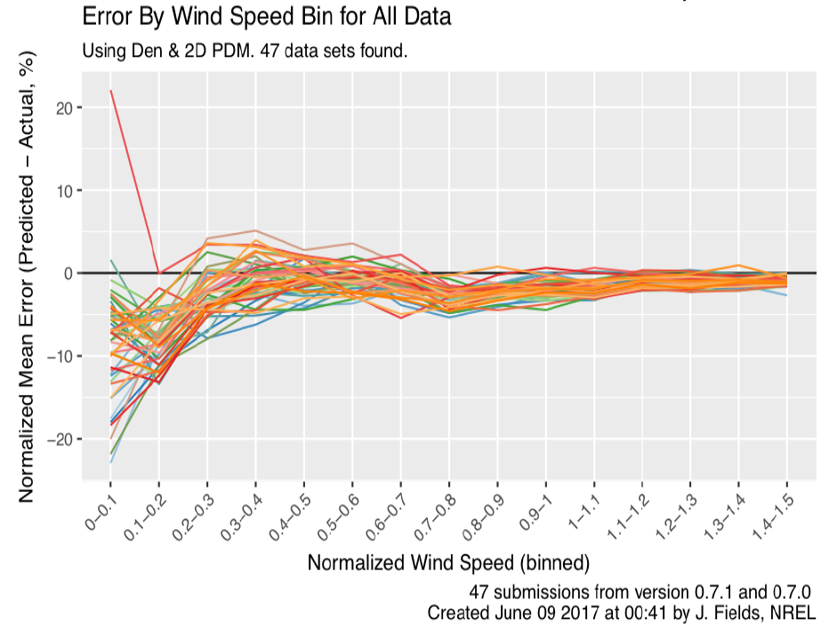
PCWG-Share-02: 2D PDM Errors by Wind Speed
Over correction at power curve ankle and knee. Most likely due to poorly specified input 2D matrix (needs revisiting in PCWG-Share-2)

Slide 17
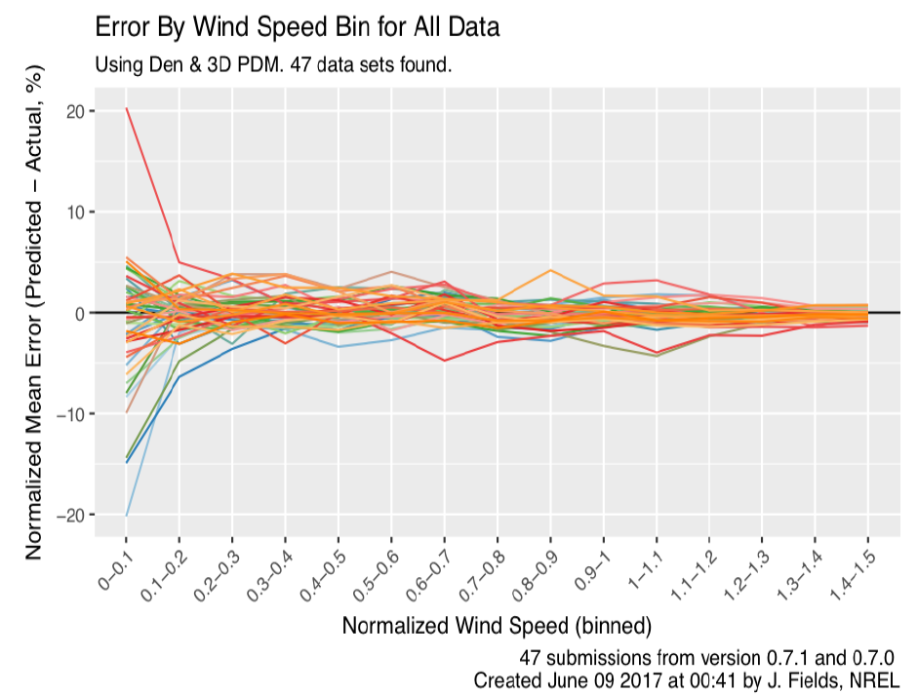
PCWG-Share-02: 3D PDM Errors by Wind Speed

Slide 18
PCWG-Share-02: 3D PDM Errors by Wind Speed

Slide 19
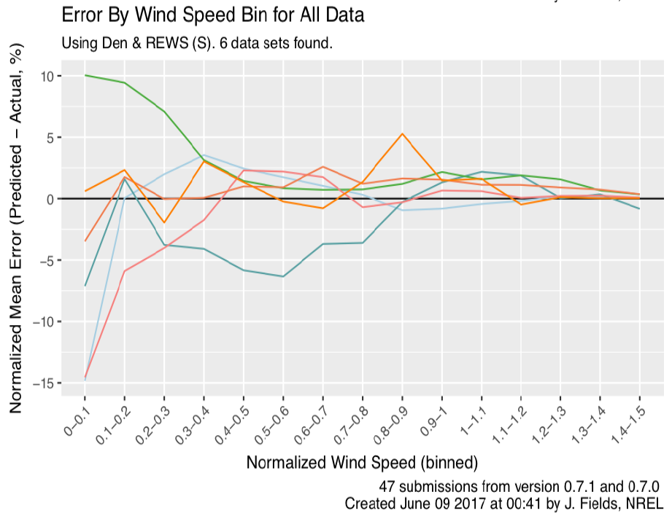
PCWG-Share-02: REWS (S) Errors by Wind Speed

Slide 20
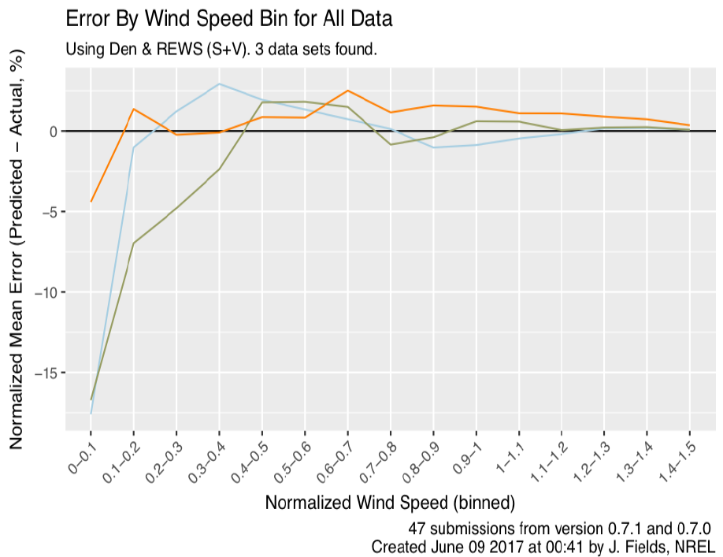
PCWG-Share-02: REWS (S+V) Errors by Wind Speed

Slide 21
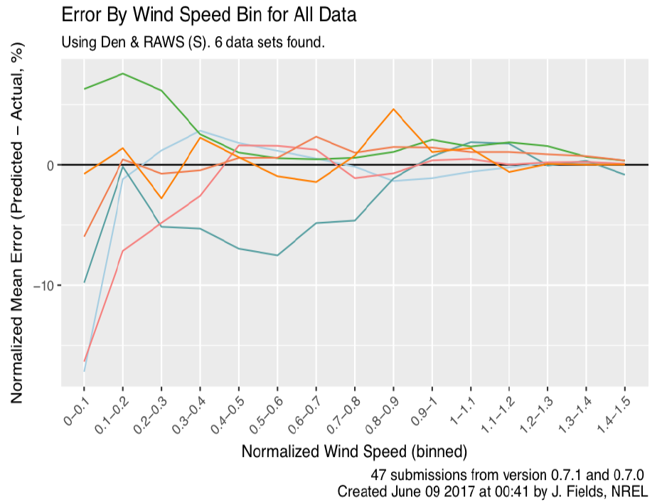
PCWG-Share-02: RAWS (S) Errors by Wind Speed

Slide 22
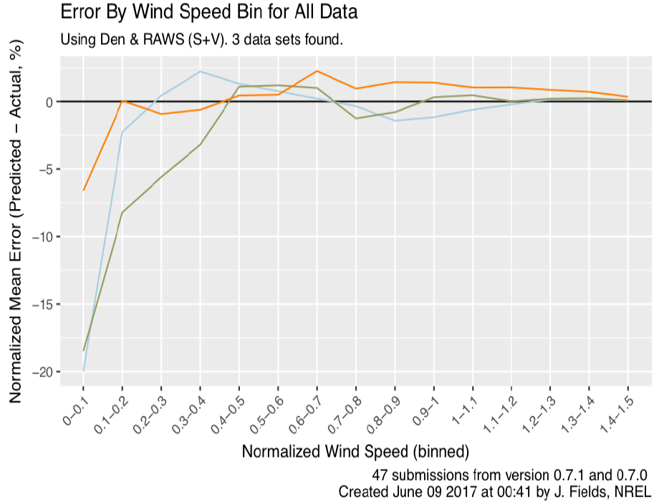
PCWG-Share-02: RAWS (S+V) Errors by Wind Speed

Slide 23
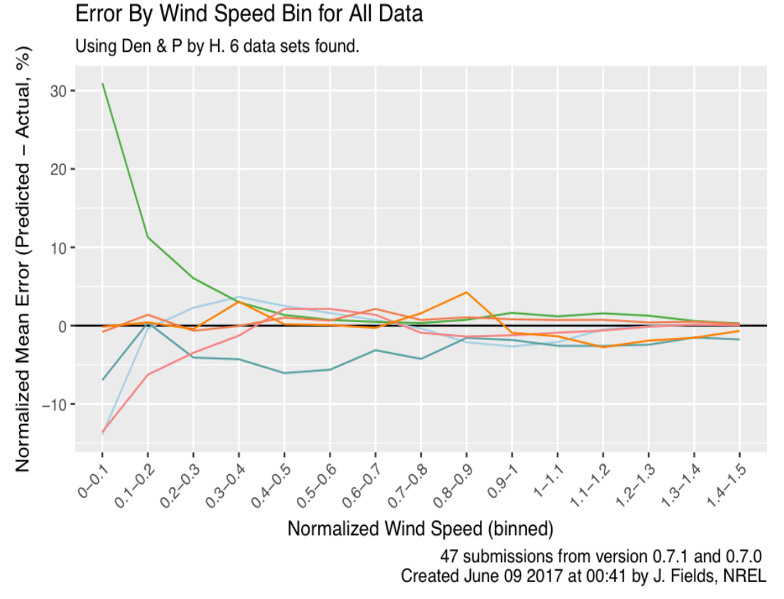
PCWG-Share-02: RAWS (S+V) Errors by Wind Speed

Slide 24
BOX PLOTS

Slide 25
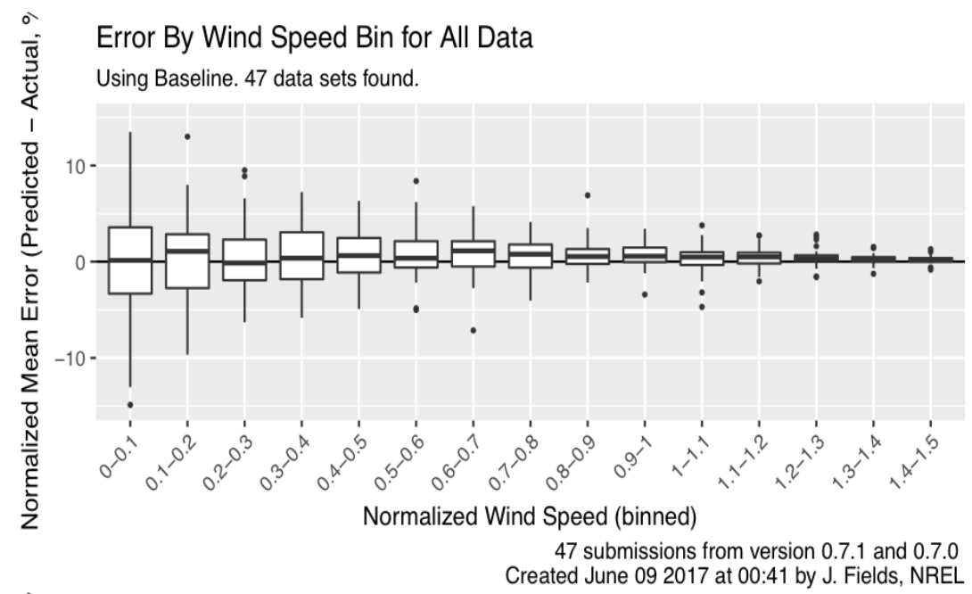
PCWG-Share-02: Baseline Errors by Wind Speed

Slide 26
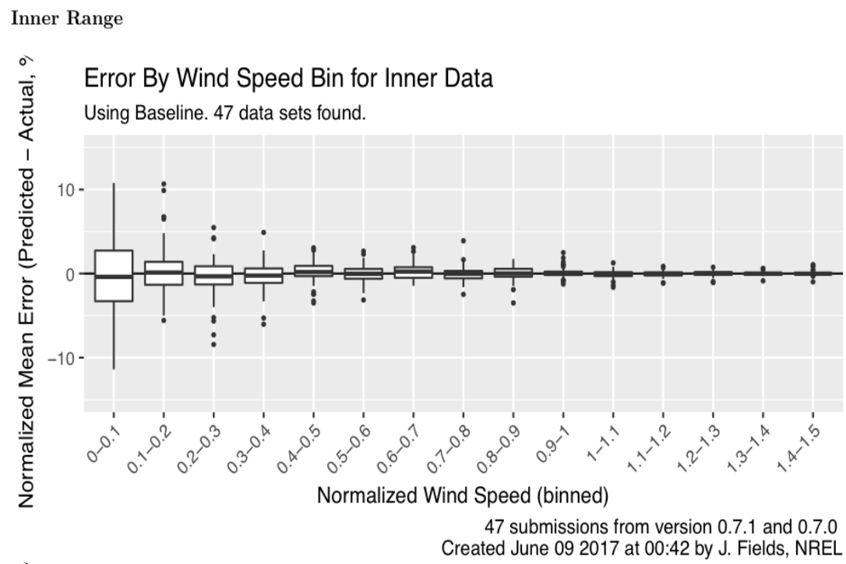
PCWG-Share-02: Inner Baseline Errors by Wind Speed

Slide 27
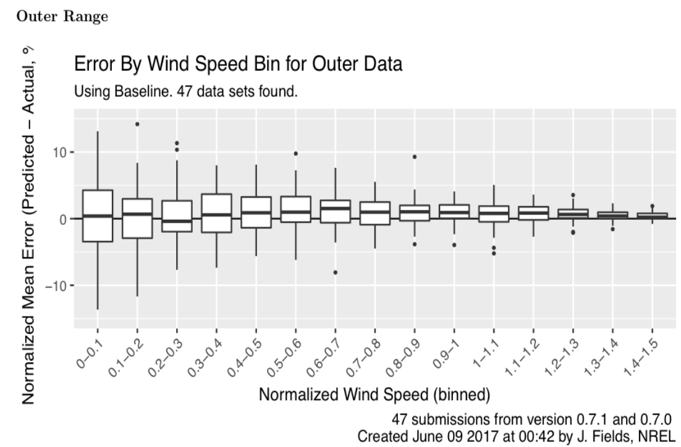
PCWG-Share-02: Outer Baseline Errors by Wind Speed

Slide 28
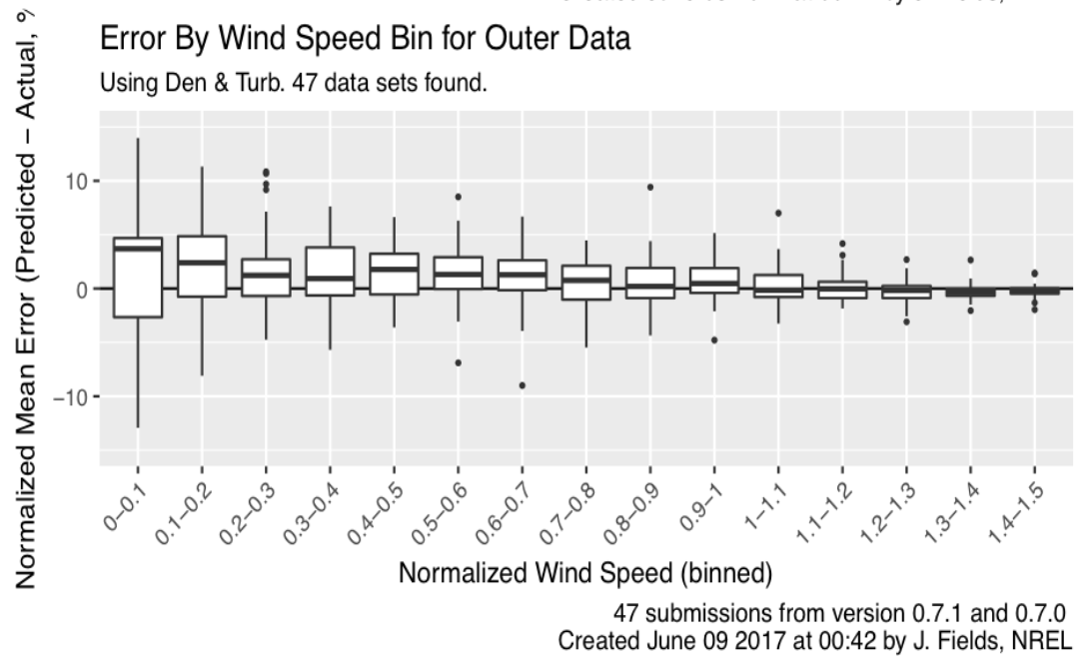
PCWG-Share-02: Outer Turbulence Errors by Wind Speed

Slide 29
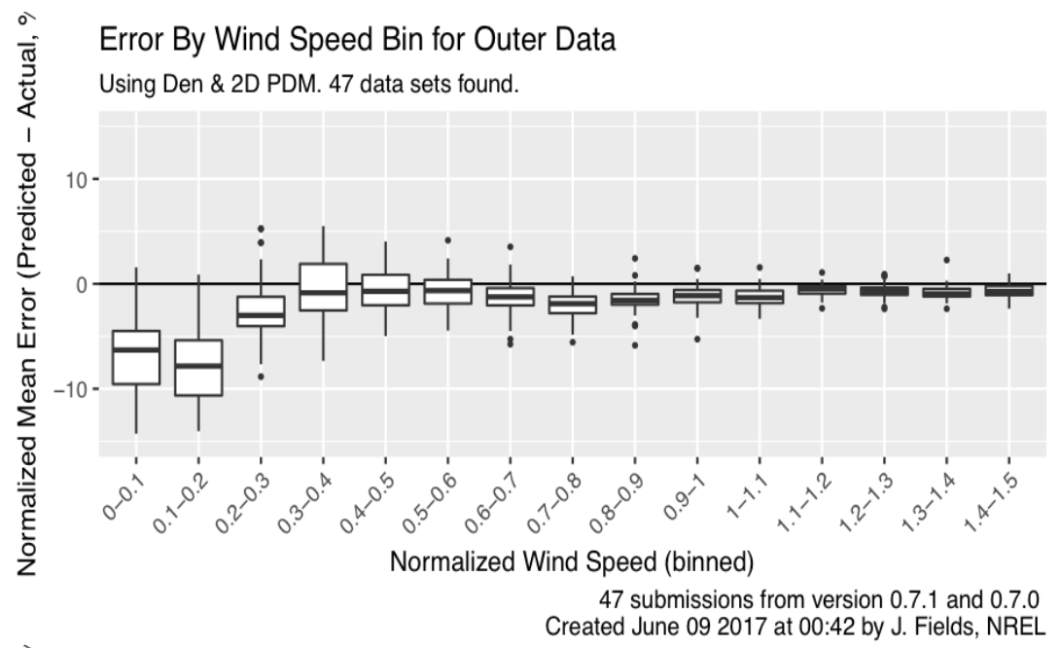
PCWG-Share-02: Outer 2D PDM Errors by Wind Speed
Over correction at power curve ankle and knee. Most likely due to poorly specified input 2D matrix (needs revisiting in PCWG-Share-2)

Slide 30
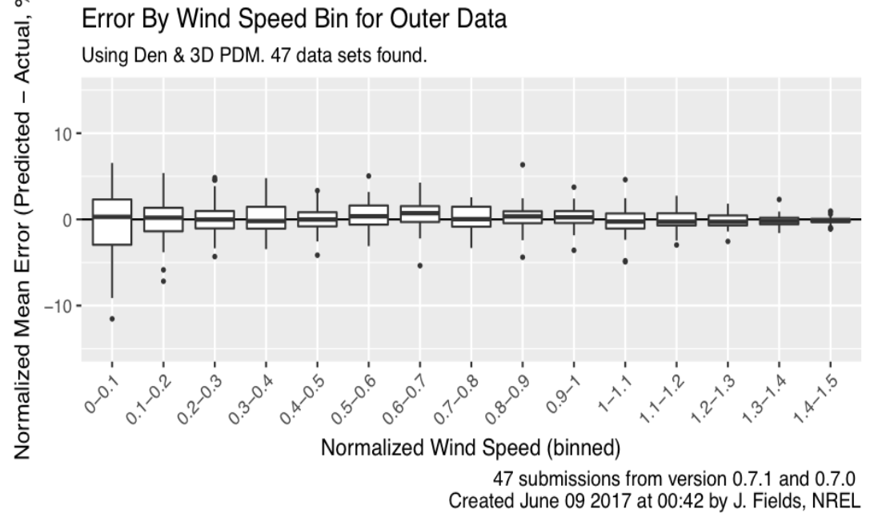
PCWG-Share-02: Outer 3D PDM Errors by Wind Speed
3D Power Deviation matrix appears to do very well. More work is needed to verify this initial result

Slide 31
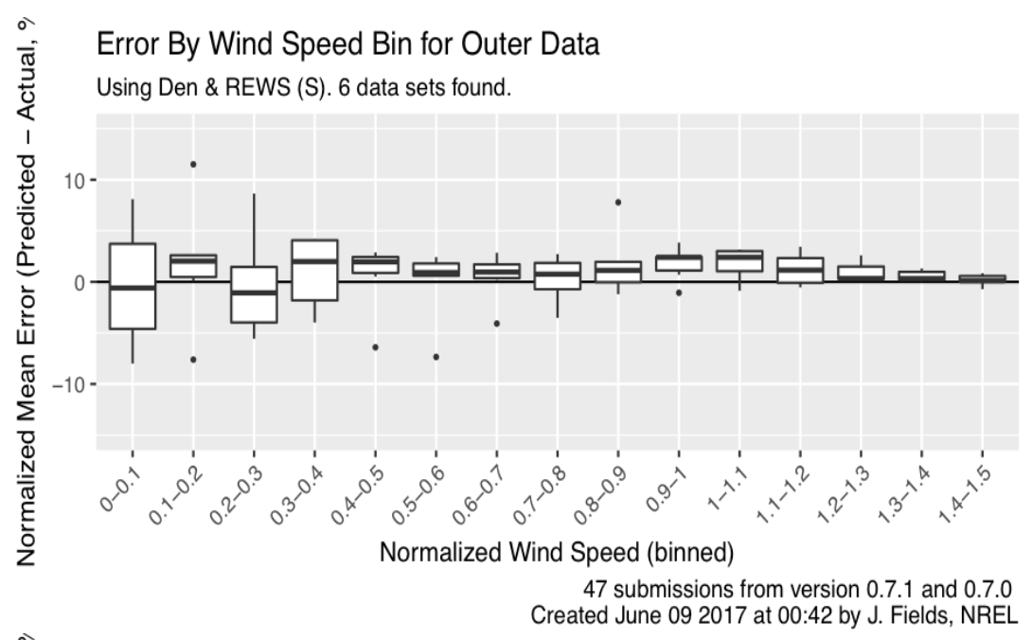
PCWG-Share-02: Outer REWS (S) Errors by Wind Speed

Slide 32
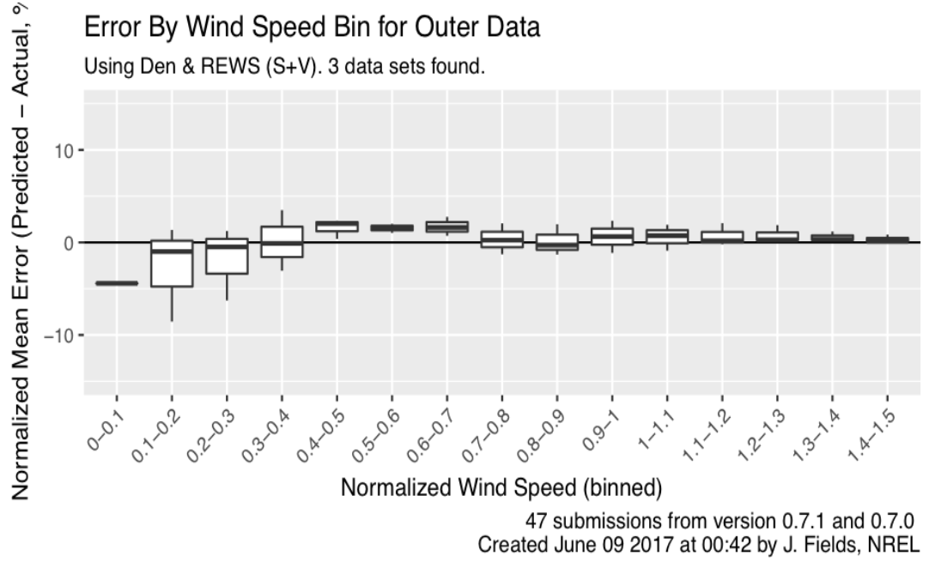
PCWG-Share-02: Outer REWS (S+V) Errors by Wind Speed

Slide 33
PCWG-Share-02: Outer REWS (S+V) Errors by Wind Speed

Slide 34

PCWG-Share-02: Outer RAWS (S) Errors by Wind Speed

Slide 35
PCWG-Share-02: Outer RAWS (S) Errors by Wind Speed

Slide 36
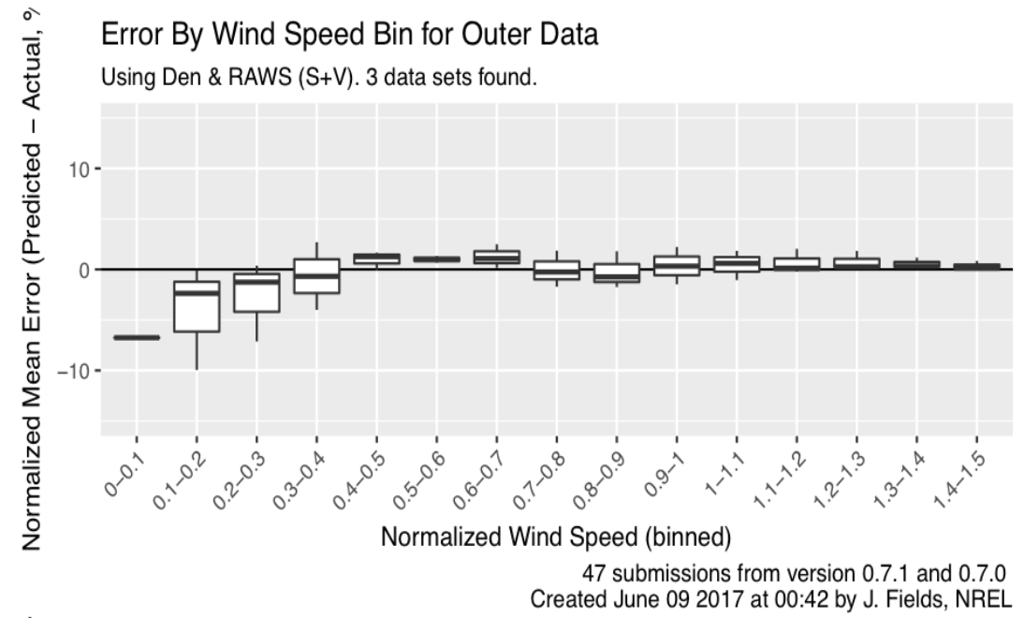
PCWG-Share-02: Outer RAWS (S+V) Errors by Wind Speed

Slide 37
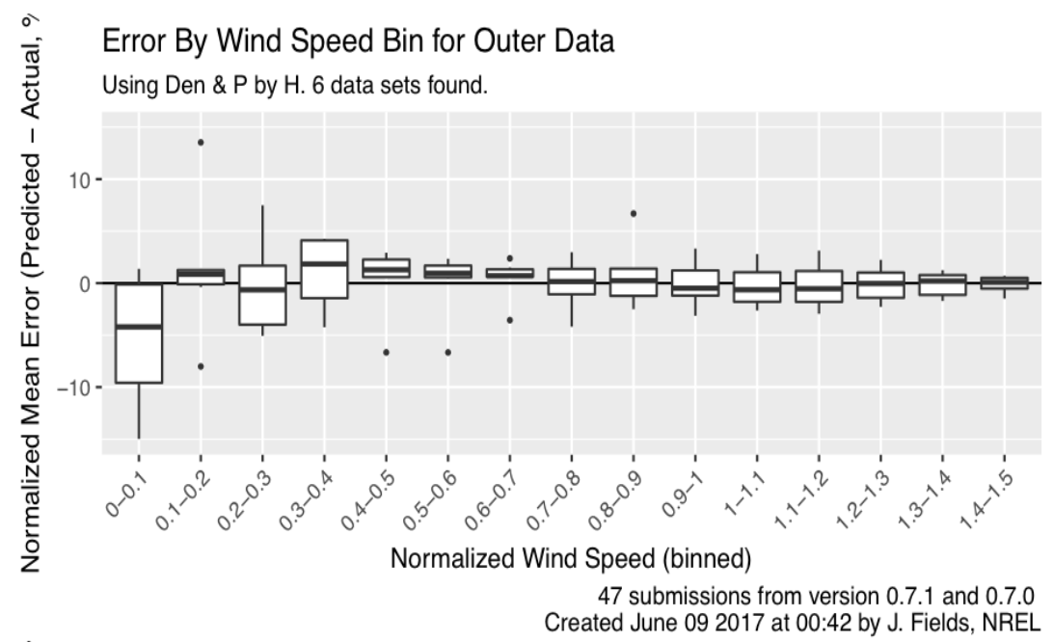
PCWG-Share-02: Outer Production by Height Errors by Wind Speed

Slide 38
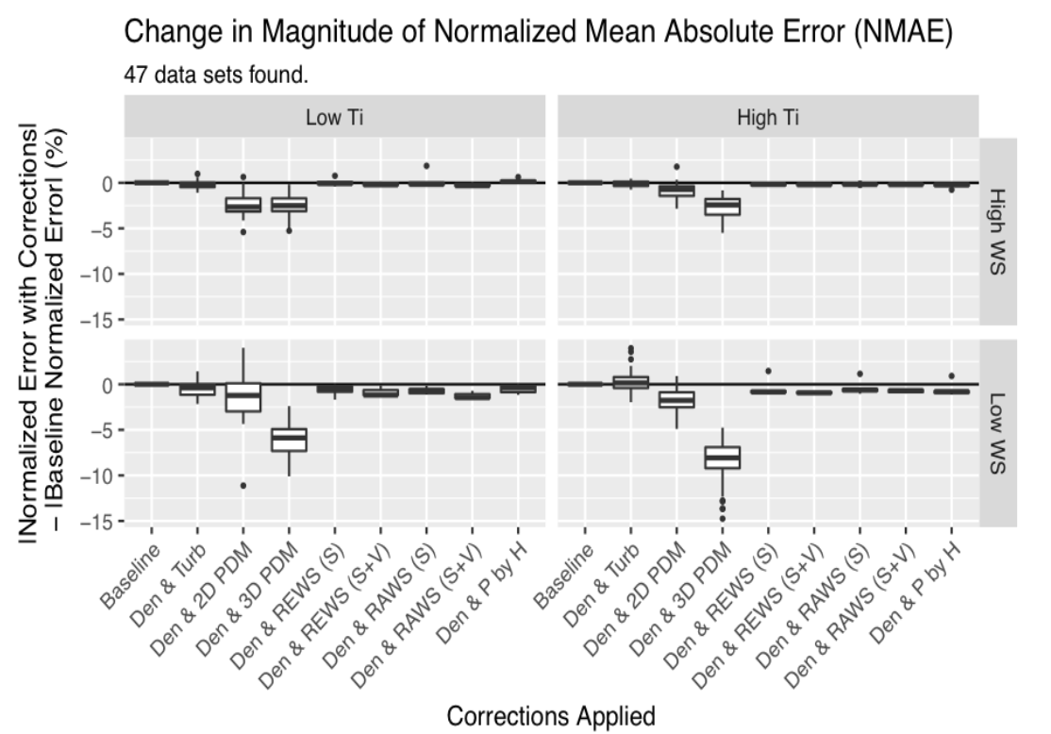
PCWG-Share-02: Errors by Method (‘Four Cell Matrix’)

Slide 39
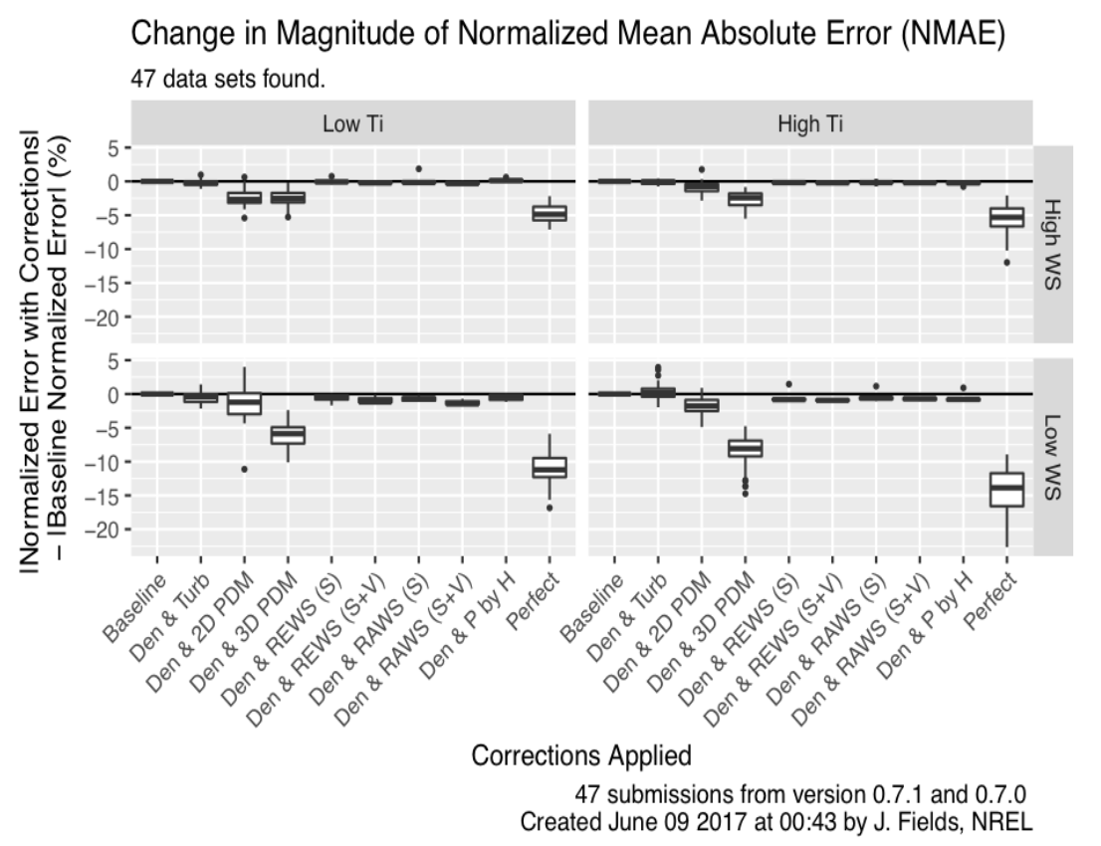
PCWG-Share-02: Errors by Method (‘Four Cell Matrix’)

Slide 40
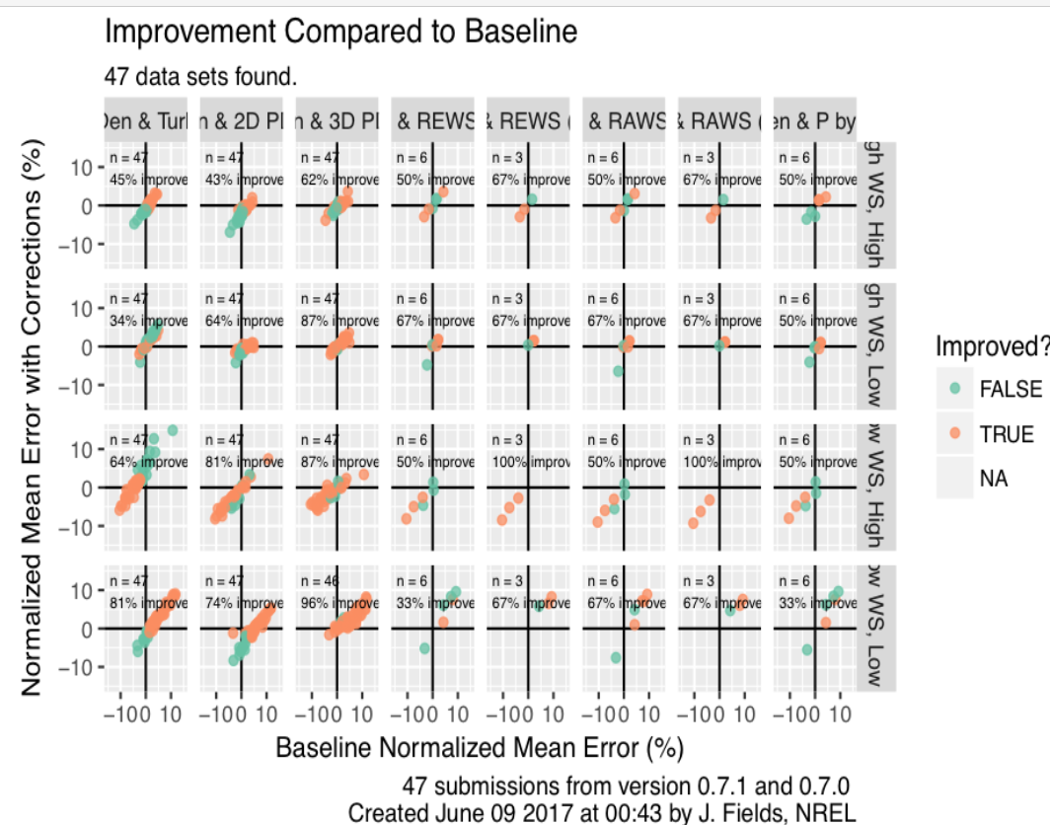
PCWG-Share-02: Improvements by Method (‘Four Cell Matrix’)

Slide 41
Join the Power Curve Working Group at: www.pcwg.org

